Slide 1
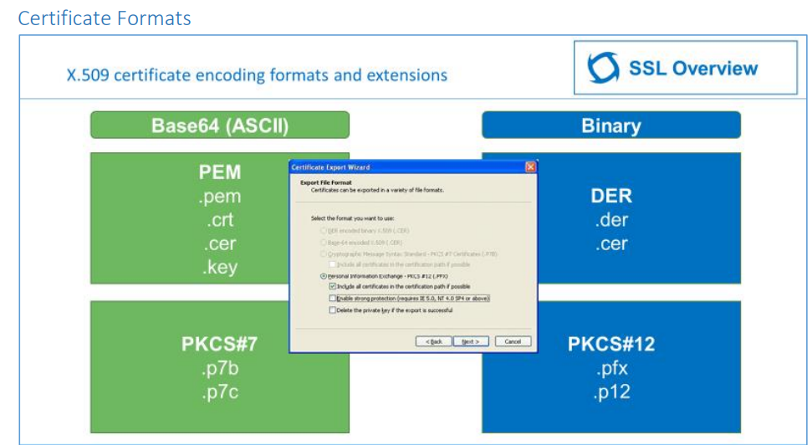
Notes:
https://www.digicert.com/content/dam/digicert/pdfs/ssl-tls-best-practice-workshop-student-guide-en.pdf

Slide 2
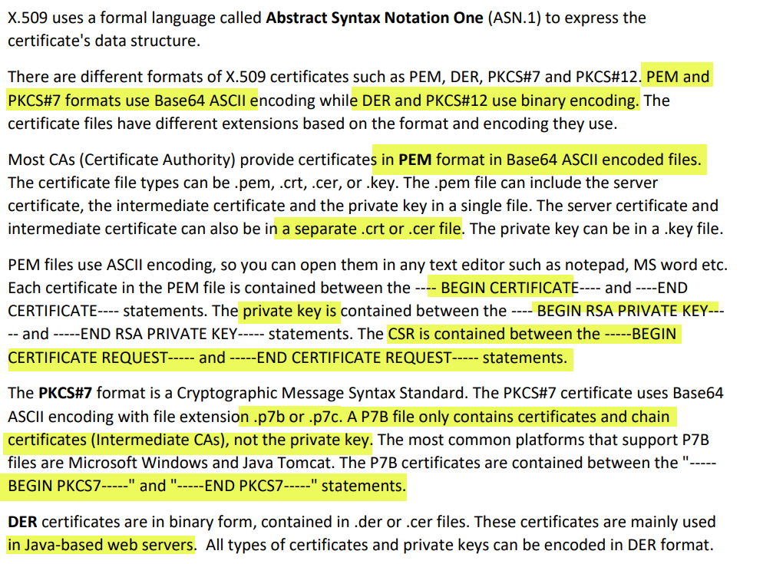

Slide 3
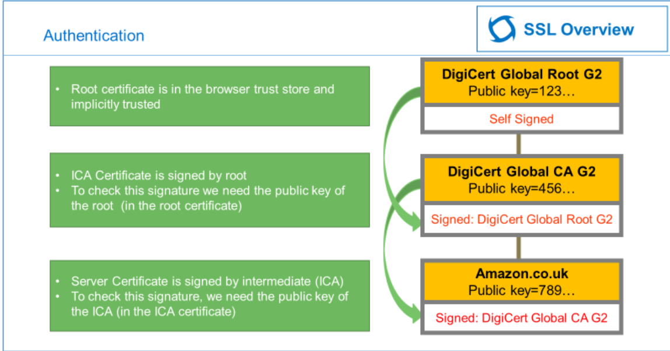
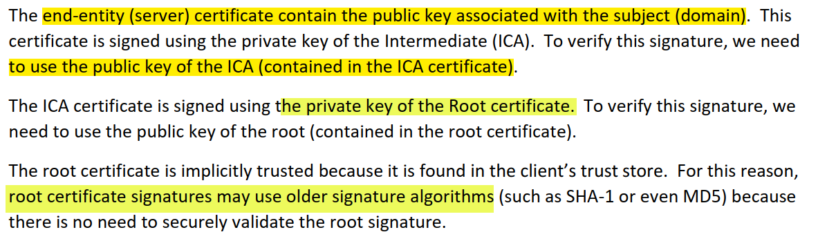

Slide 4
SSL/TLS Application Layer
Transport mode/IPSEC
Tunnel mode/IPSEC
Layer 2/MACSEC

Slide 5
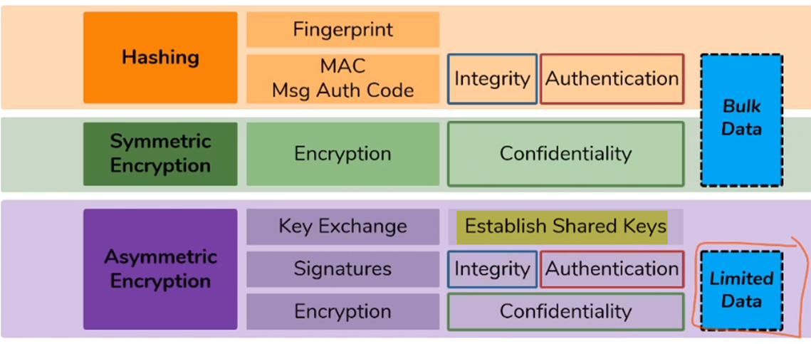
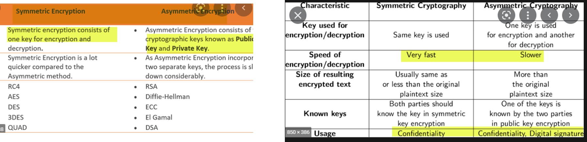

Slide 6
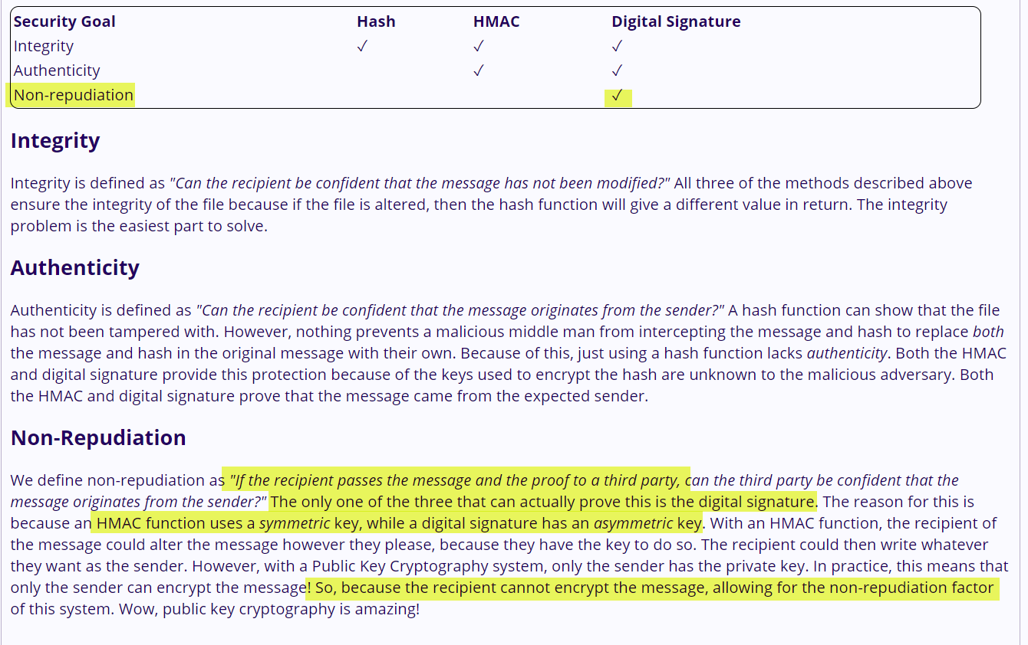

Slide 7
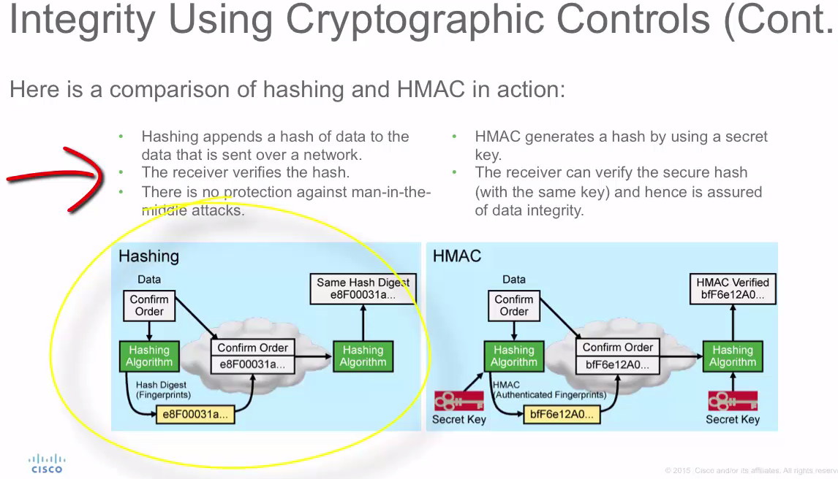

Slide 8
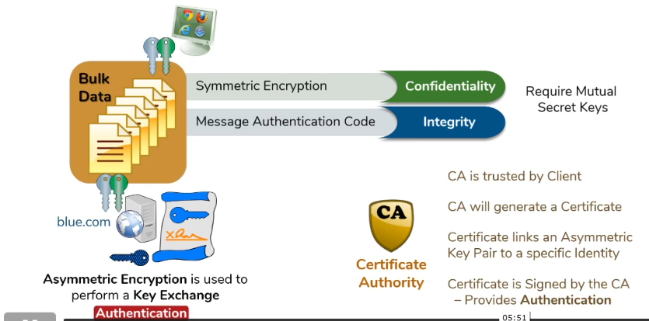
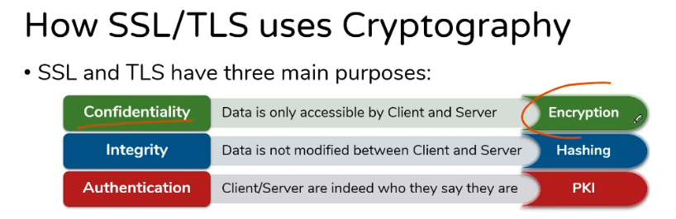

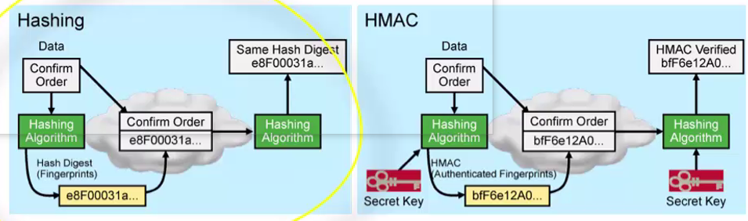

Slide 9
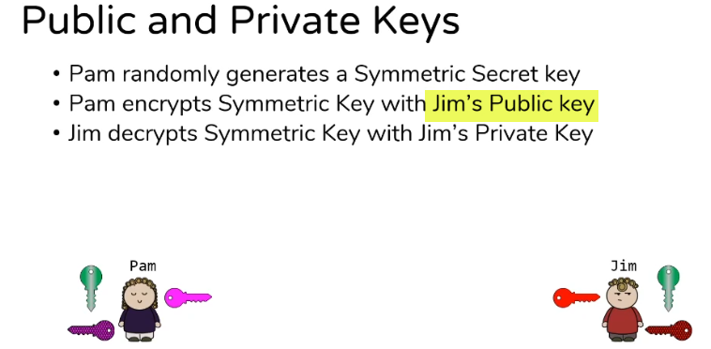
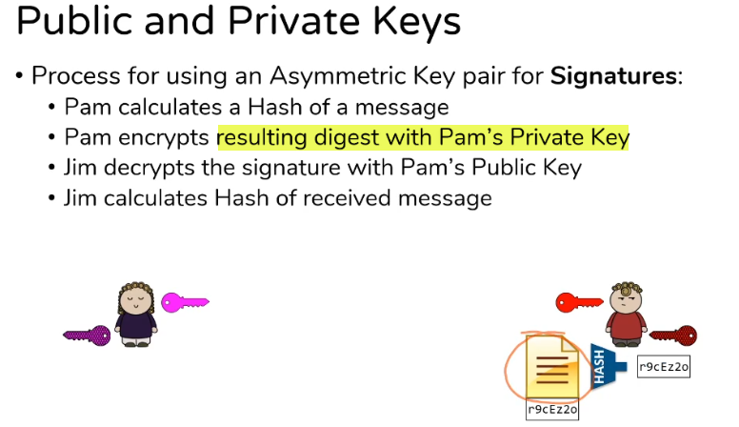
Encryption is done using receiver’s public key
Signature is done using sender’s private key
PAM
Message
Hash of Message
Encrypt Hash using PAM’s Private key
Note : Though Signature use Private Key ,you are not using to Encrypt the Whole Data but you are Encrypting Hash of the Data(Hash is Small representation of the data)
Message
Hash

Slide 10
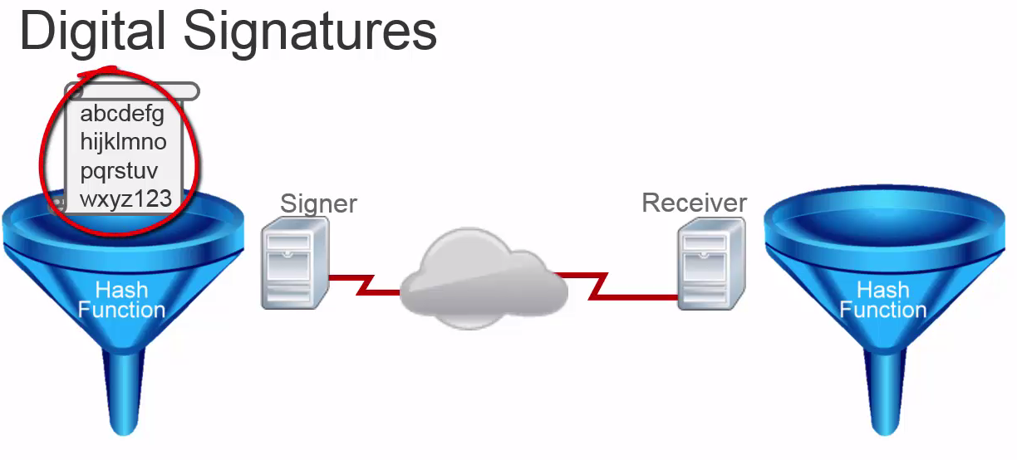
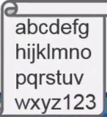

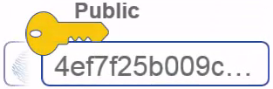
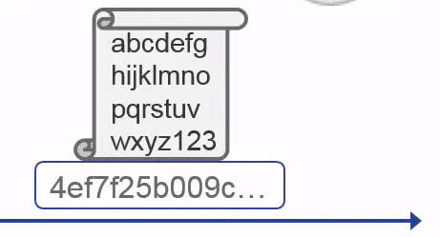


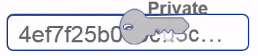
Digital Signature = Encrypted hash of data
Read Notes :
DATA
Encrypted Hash of DATA
Hash of DATA
+
Private key
DATA
Encrypted Hash of DATA
match
Notes:
1 Using Asymmetric Encryption can be used for authenticity of the Sender but it’s computationally expensive if you need to lot of redata .
Digital Signature solves that problem using hash + Asymmetric Encryption
As Above diagram shows :
1 Signer run the data through hash function & received hash is than encrypted with it’s private key ( we are encrypting the hash not the whole data so less computation) , Resulting signature we send with the original document.
2 On Receiver we run the data through hash function which gives the resulting hash (end with 003c) , at the same time we decrypt signature with Signer’s public key & if result’s match than we can verify the authenticity .
Digital Signature :
1 Origin Authentication ( Only signer’s pubic key can decrypt the signature encrypted by signer private key)
2 Data Integrity : ( if finger print match so data has not been altered)
3 Non-repudiation : ( Only signer’s private key produce the signature , can not deny that

Slide 11
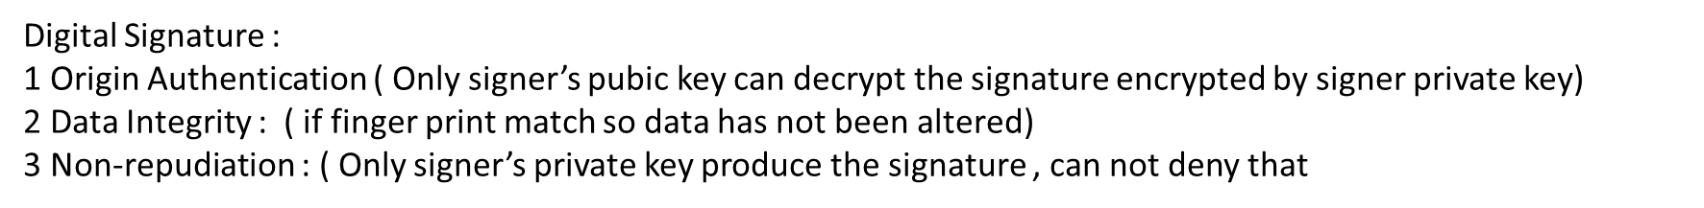
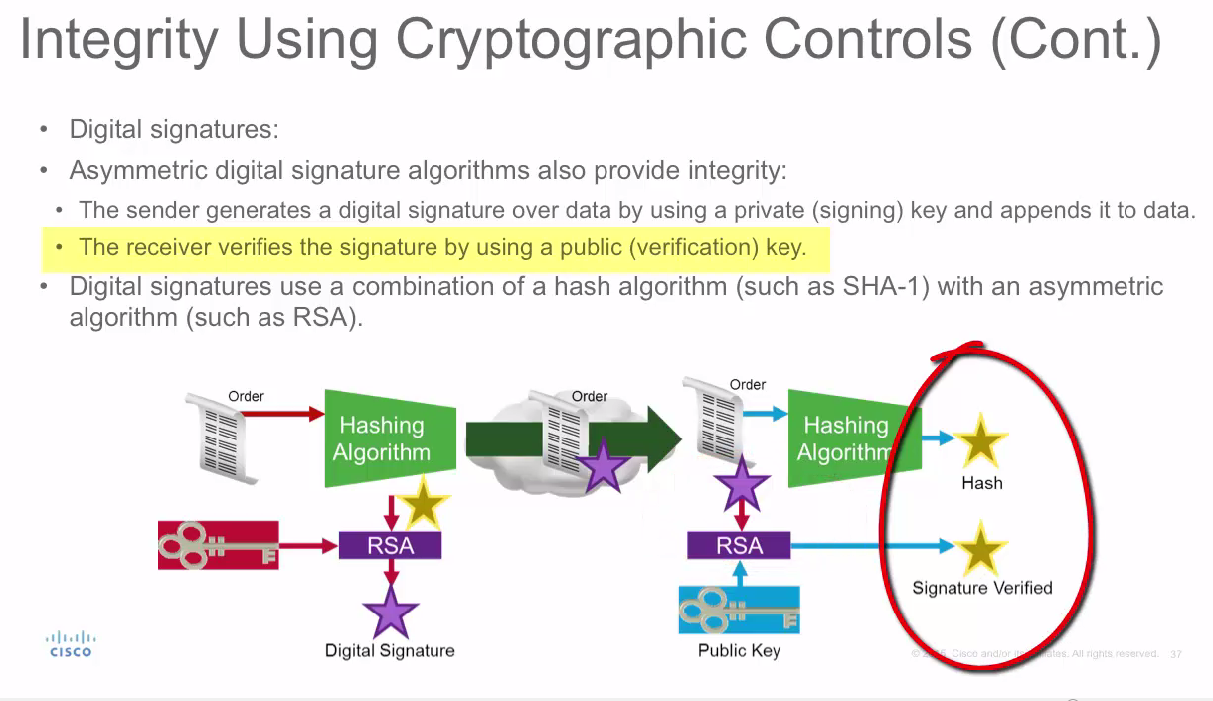

Slide 12
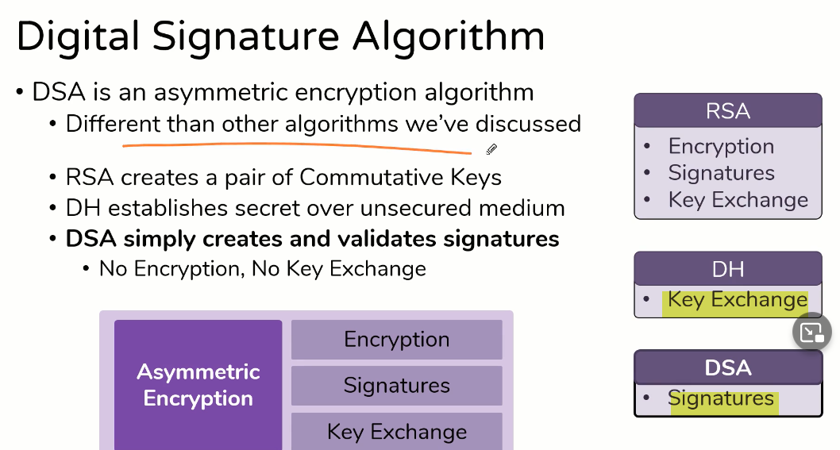
Asymmetric Cryptography

Slide 13
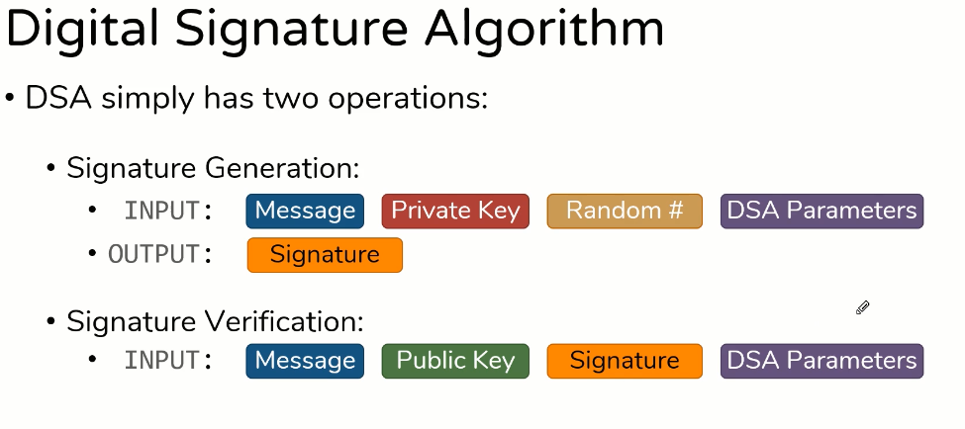
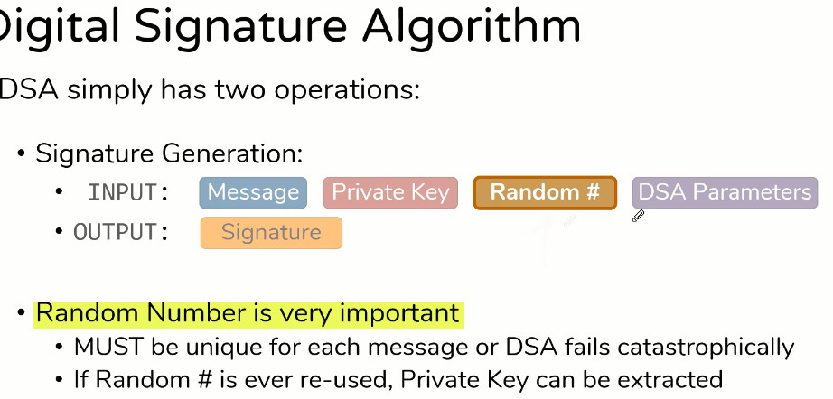

Slide 14
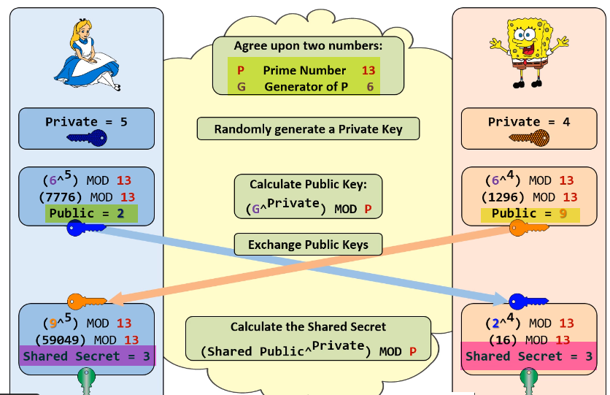
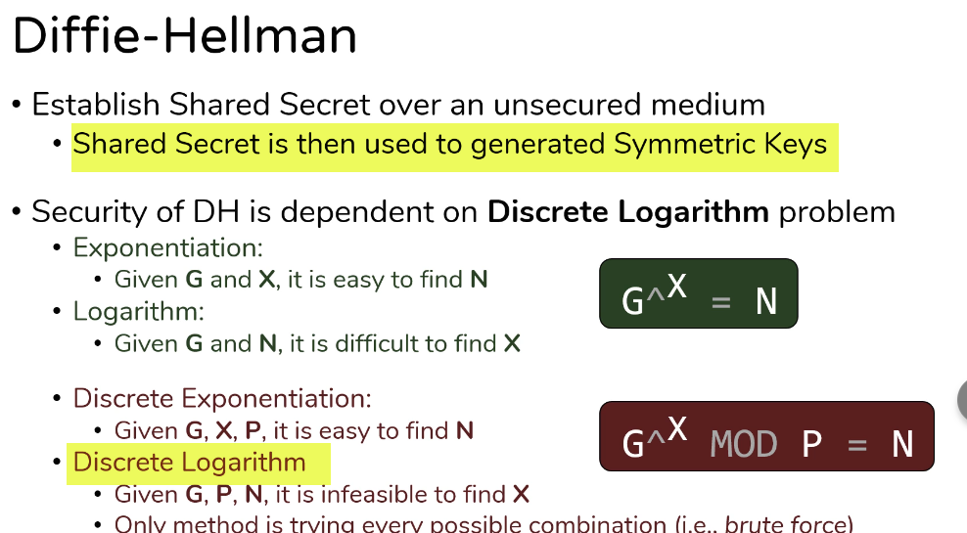
Used as secret key for HMAC

Slide 15
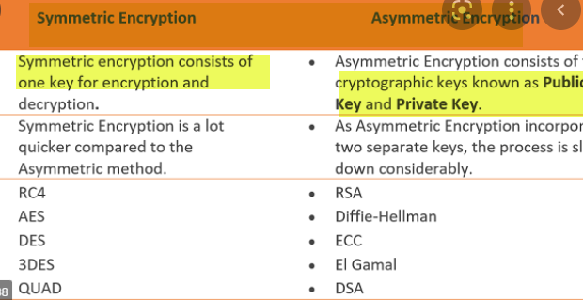
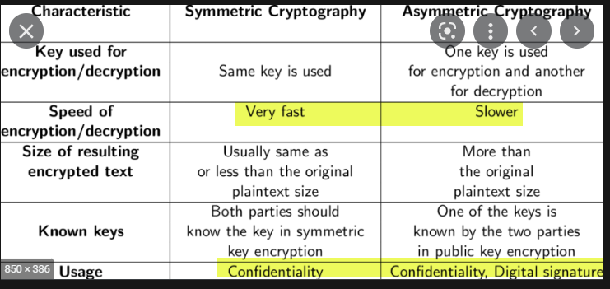
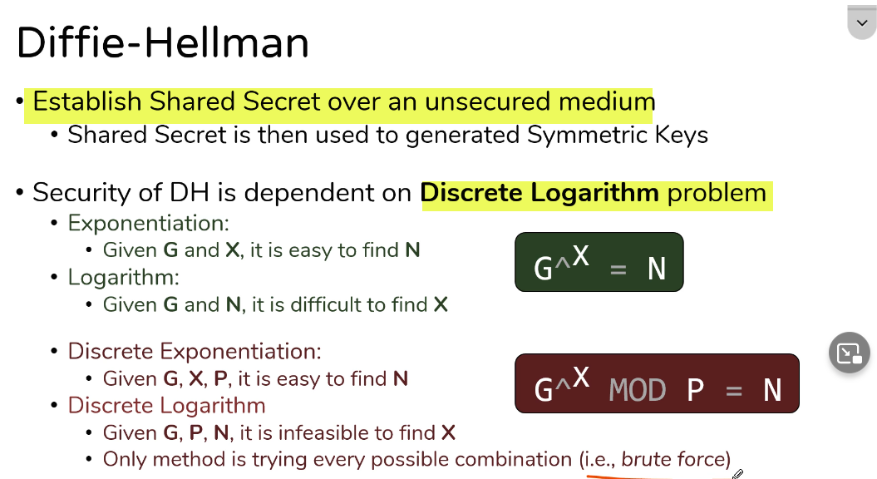
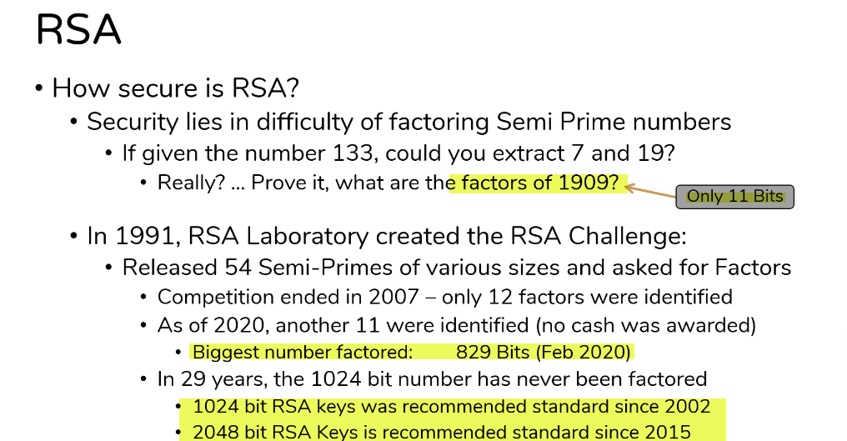

Slide 16
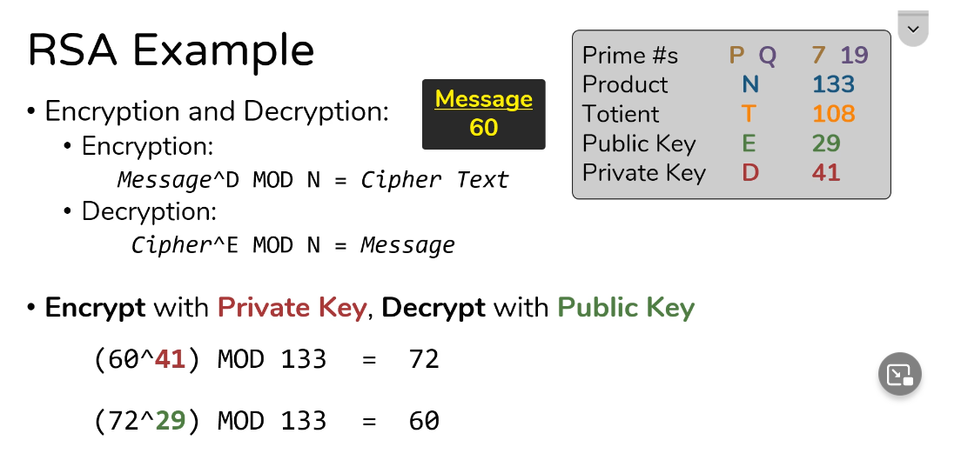
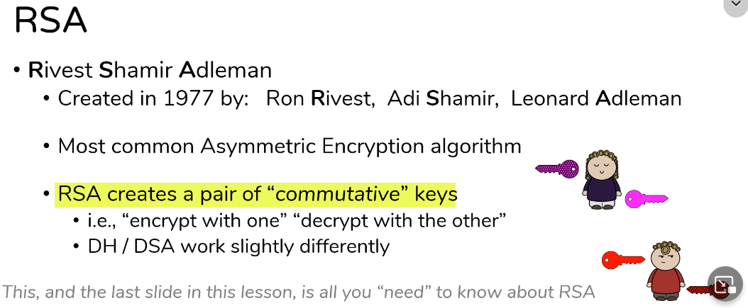

Slide 17
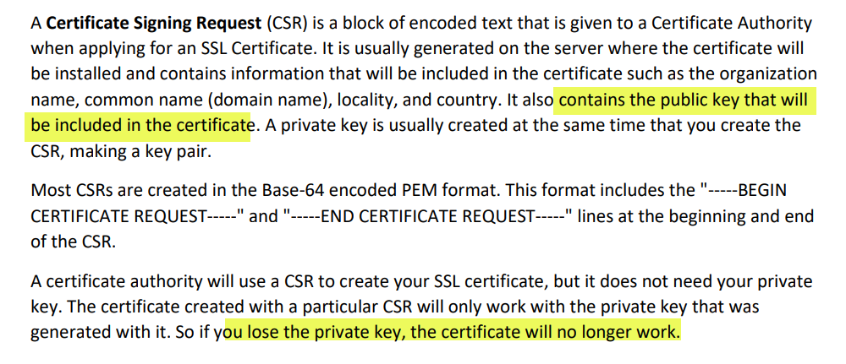
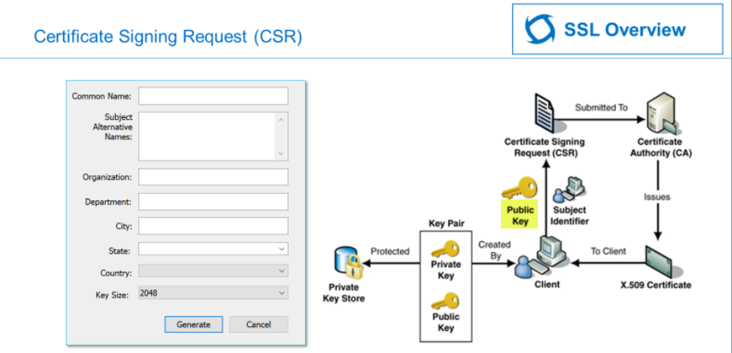

Slide 18
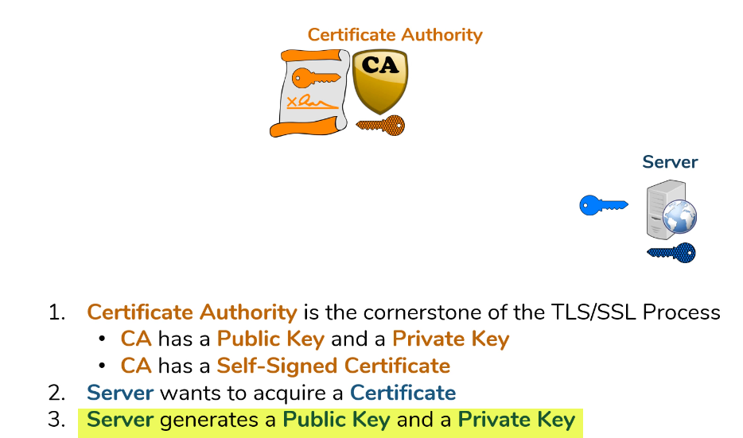
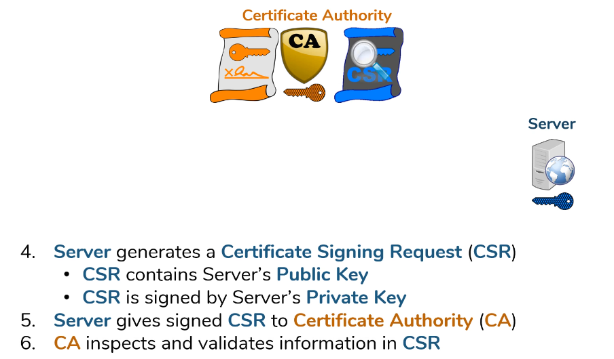
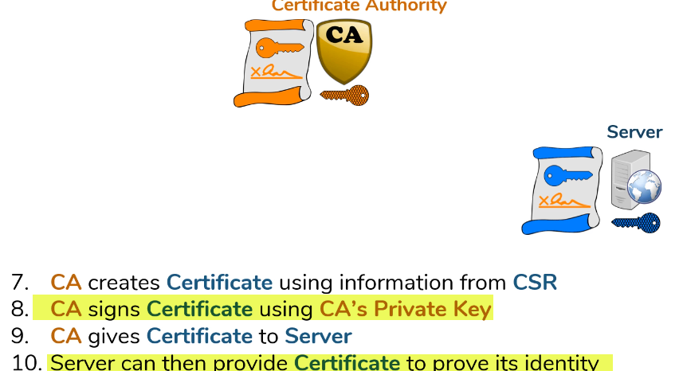
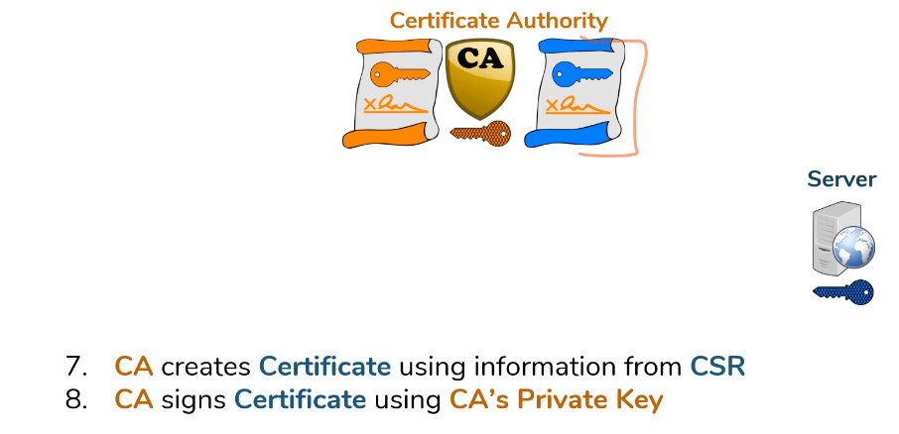

Slide 19
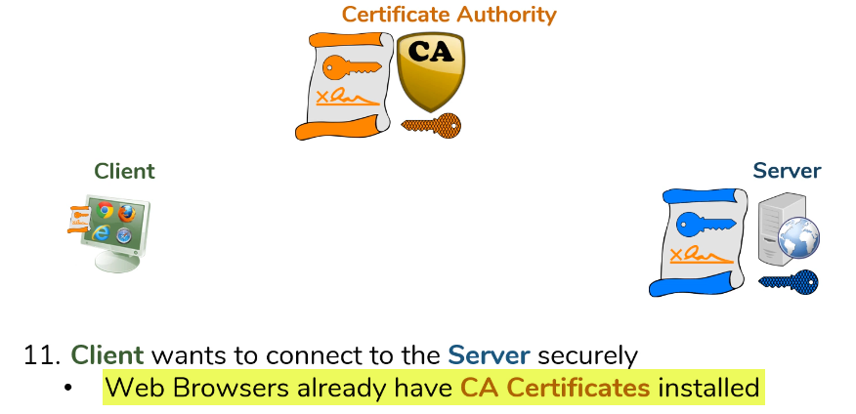

Slide 20
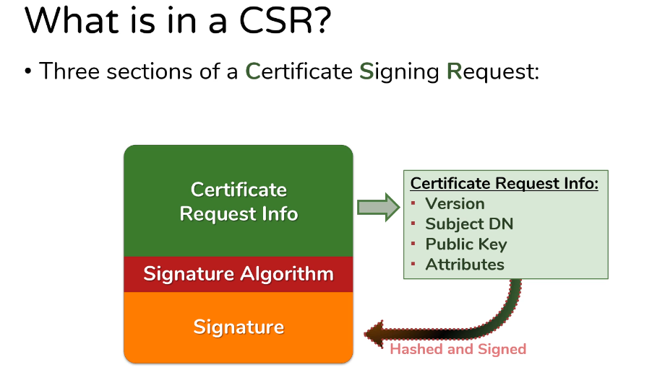
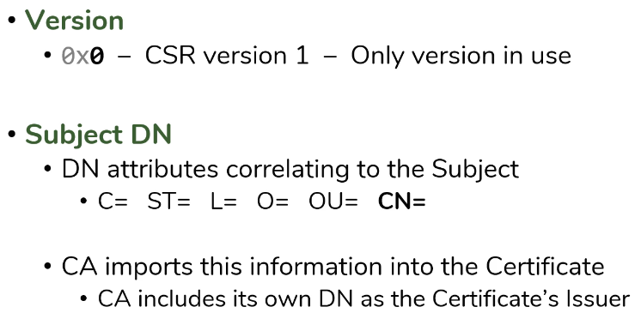
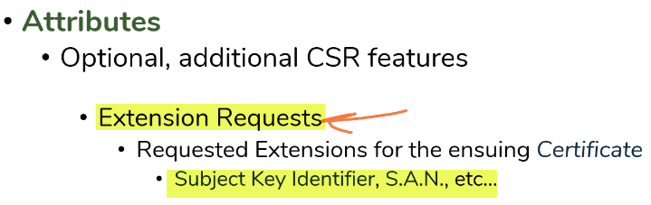
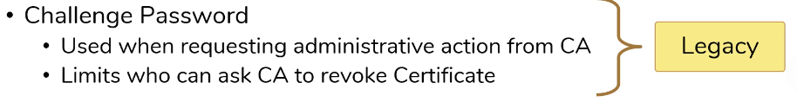
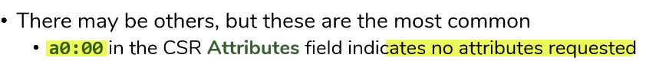

Slide 21
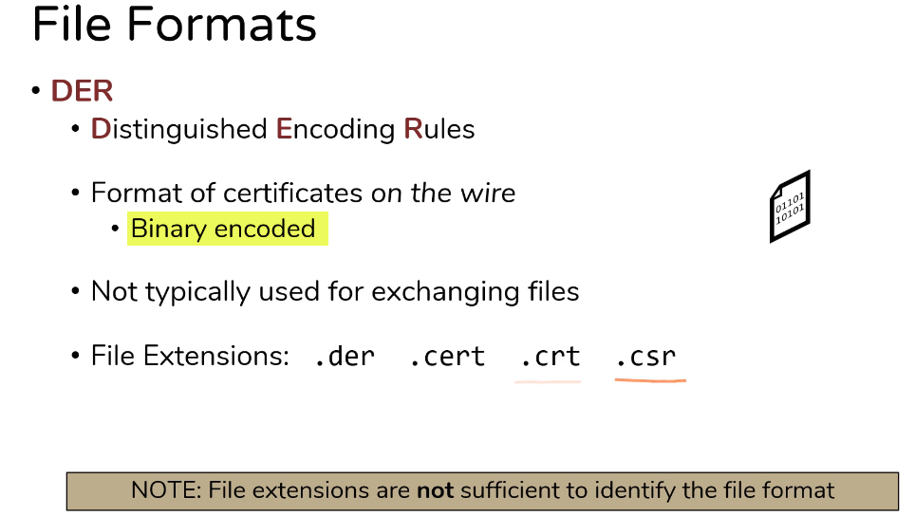
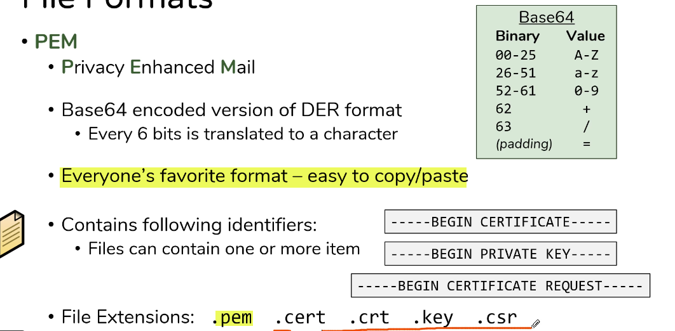

Slide 22
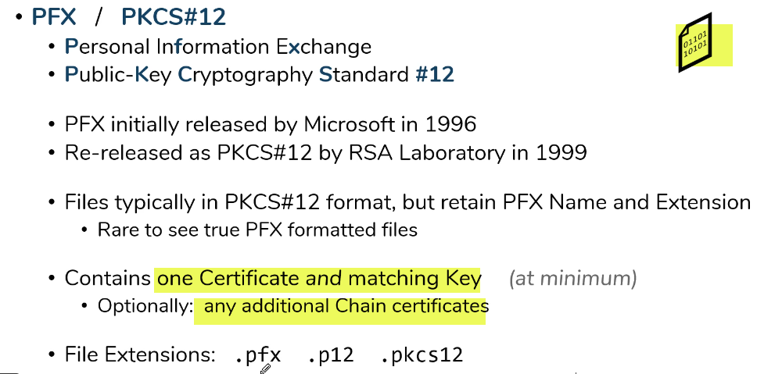
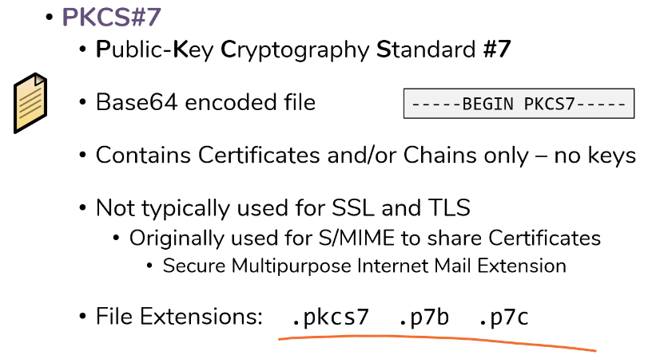
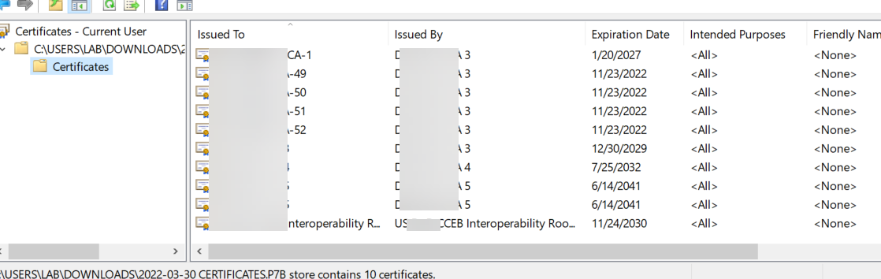

Slide 23
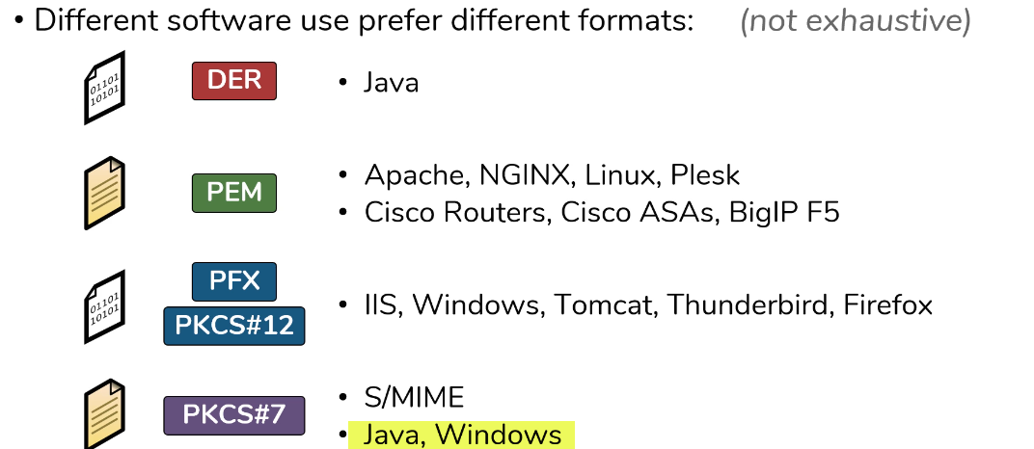

Slide 25
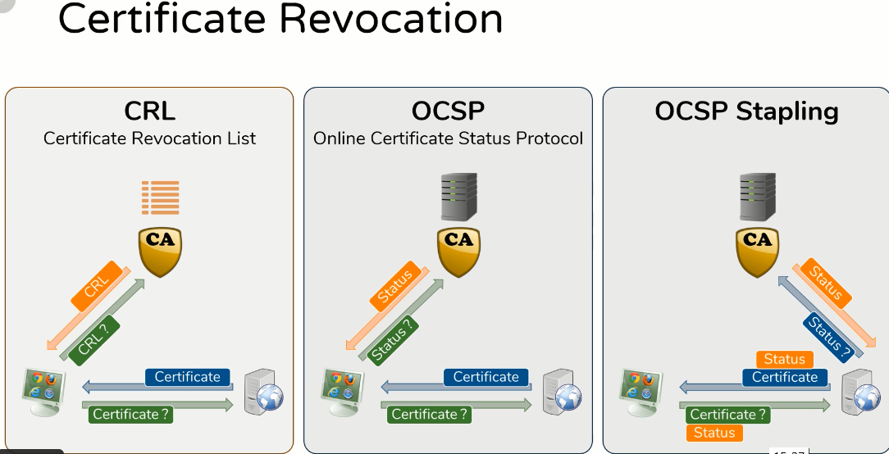

Slide 26




Slide 27


Slide 28


Slide 29


Slide 30



Slide 31



Slide 32




Slide 33


Slide 34



Slide 35


Slide 36


Slide 37


Slide 38


Slide 39



Slide 40



Slide 41


Slide 42


Slide 43


Slide 44


Slide 45



Slide 46


Slide 47


Slide 48



Slide 49



Slide 50


Slide 51


Slide 52



Slide 53


Slide 54


Slide 55


Slide 58

Initializing a connection in SSH consists of:
• Negotiating the version of the protocol to use
• Negotiating cryptographic algorithms and other options to use
• Negotiating a one-time session key for encrypting the rest of the session
• Authenticating the server host using its host key
• Authenticating the user using a password, public key authentication, or other means.
After this, data can be exchanged, including terminal data, graphics, and files.

Slide 59


Slide 60


